Slide 1
Bridging the Gap: What is Required for Success with College-Level Literacy Demands?
Facilitators: Rick Fisher and April Heaney
Panelists: Steve Barrett, Scott Freng/Sean McCrea, Joyce Stewart, Melissa Terry-Bowles, and Brianna Wright

Slide 2
A brief overview
Setting a foundation
Hearing from college instructors across the disciplines
Exploring some possible ways of bridging the gap
Collecting feedback from you about a specific literacy issue: research reading and writing

Slide 3
Part Ia: Contextualization
About us
  Facilitators
Some context for this session
  Institution and state level
  National
A definition for “literacy”

Slide 4
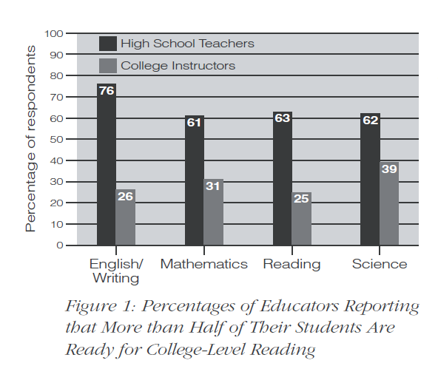
Part of the national conversation
(from ACT National Curriculum Survey, 2009)

Slide 5
Part of the national conversation
Elizabeth Wardle: “As a field, we know little to nothing about the transfer of writing-related knowledge from FYC. … In summing up over a century of research in psychology, David Perkins and Gavriel Salomon claim that transferring school knowledge from one situation to another is difficult, and that most school settings do not facilitate transfer: ‘very often,’ they conclude, ‘the hoped-for learning transfer does not occur.’”

Slide 6
Part of the national conversation
Jennifer Wells: “There is no way for high schools to prepare every student to succeed in every possible iteration of a first-year writing course, let alone every course in which a first-year college student will be asked to write. Even when it would seem like most participants had to analyze something in first-year writing, there was no agreement on what an analysis essay should look like.”

Slide 7
Part of the national conversation
Fraizer, summarizing Coxwell-Teague: “Students don’t see the connection between FYC writing and writing done in other classes, but ... about half of the students do later use some of the techniques. … The use of these techniques increases as students advance to junior or senior status.”
Addison/McGee: “96-100% of the students and faculty … think writing will be somewhat important or very important to their future success, and 93-100% believe they will write often or very often after graduation.”

Slide 8
Part Ib: Reflection
Some questions to answer
  What SKILLS do you currently teach which you believe contribute most to your students’ ability to read and write at the college level?
  What HABITS OF MIND do you currently develop that you believe contribute most to your students’ ability to read and write at the college level?
  What NON-CLASS OPPORTUNITIES do you provide for students to develop identities that may contribute to their reading/writing success at college?
  What SKILLS or HABITS OF MIND do you think that college instructors feel are least developed among their incoming students?

Slide 9
Part Ic: Discussion
Possible topics
  Points of intersection?
  Points of diversion?
  Points of success?
  Points of confusion/frustration?
AND, some prediction:
  What do you expect to hear from college instructors about perceptions of students’ reading/writing preparedness?

Slide 10
Part IIa: Panelists
Steve Barrett, Engineering
Scott Freng/Sean McCrea, Psychology
Joyce Stewart, First-Year Composition
Melissa Bowles-Terry, Honors Program/UW Libraries
Brianna Wright, Life Sciences

Slide 12
Part IIb: Responding to Panel
Table discussion
  What matched your expectations?
  What did you hear that surprised you?
  Where do you want more clarification?
Q&A / Response time

Slide 13
Part IIIa: Responding to the gap
“It’s an articulation problem.”
  There’s lack of communication between HS and college teachers…
  ….because we don’t know what skills are being taught
    .… because we don’t know what habits of mind are being encouraged

Slide 14
“It’s a problem with knowing how to ‘teach for transfer.’ ”
“It’s not a problem at all: the disconnects between high school and college curriculum are appropriate/necessary.”

Slide 15
“It’s about lack of COMMUNICATION.”
View the prompts from the panelists. (See separate handout.)
Attend events like this one, and like Teaching Writing in Wyoming (April 7-8, 2013)
Initiate dialogue (and see the plan that Lander Valley High School developed)

Slide 16
“It’s about SKILLS.”
National Curriculum Survey, 2009: Of all the skills rated by postsecondary instructors and high school teachers, the one with the largest difference in perceived importance was that of “writing to analyze literature,” ranked 18th in importance by high school teachers, but only 87th by postsecondary instructors.

Slide 17
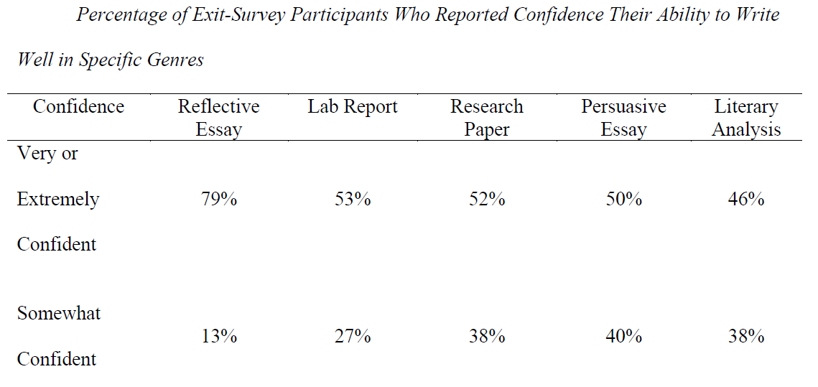
“It’s about SKILLS.”
(table from Jennifer Wells, Millennials Strike Back, 2011)

Slide 18
“It’s about SKILLS.”
Dan Fraizer: “[College] instructors most often … labeled the following items as ‘very important’: narrowing topics, formulating main ideas, paraphrasing, summarizing, synthesizing, analyzing, supporting claims, structuring arguments, paragraphing, introductions, conclusions, organization, evaluating library sources, incorporating sources into texts, evaluating on-line sources, avoiding plagiarism, and creating works cited pages.”

Slide 19
“It’s about HABITS of MIND.”
NCTE/WPA/NWP’s “Framework for Success in Postsecondary Writing” identifies eight habits of mind essential for success in college writing:
    Curiosity
    Openness
    Engagement
    Creativity
    Persistence
    Responsibility
    Flexibility
    Metacognition

Slide 20
It’s about new teaching methods:
How do I “TEACH for TRANSFER”?
Beaufort: Create opportunities for metacognition, reflection, abstraction of principles, and “mindfulness” of the rhetorical context.
Salomon/Perkins: Recognize the value of both “high road” and “low road” approaches to transfer.

Slide 21
“The differences are supposed to be there.”
Fanetti, Bushrow, and DeWeese: “High school students learn to follow a specific set of rules; college students learn that there are no rules—or, better, that the rules change daily.”

Slide 22
Part IV: Collecting ideas about research literacies
Questions: Back page of handout
If time: discuss approaches and struggles
Please leave the back page with us!

Slide 23
Thanks for coming!

